Slide 2
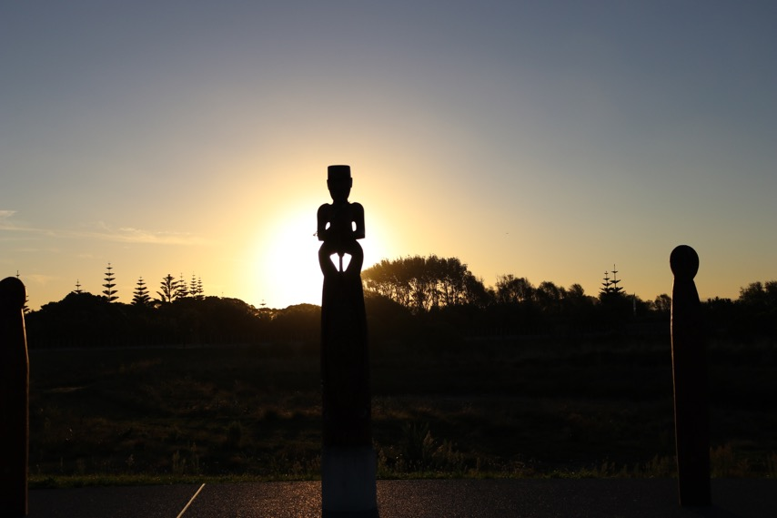
Te Hononga pātui i raro o Te Tiriti o Waitangi He Kōrerorero
Notes:
Te Tiriti o Waitangi – Partnership
Nau mai ki te whare kōrero o Ako Panuku – he whare e pūpuri ana i te wairua o Te Tiriti o Waitangi, ka mutu i te wairua hoki o Mahi Ngātahi.
Ko te aronga nui o tēnei whakaaturanga ko te wānanga i te paerewa nei kia mārama katoa ngā kaiako ki te ngako o te kōrero – Te Tiriti o Waitangi – Mahi Ngātahi.
Kia tirohia ngā paerewa katoa, haere ki: https://educationcouncil.org.nz/content/our-code-our-standards
Hei whakamahi i te whakaaturanga nei:
Āta whakaarohia te whakamahinga o te whakaaturanga nei kia whai hua ai ngā kaiako katoa.
Whakahaerehia he hui mō tētahi rangi anake, wāwāhia rānei te whakaaturanga kia toru, kia whā rānei ngā hui.
Āta whakaarohia ko wai ka whakahaere i ngā hui.
Tirohia ngā whārangi tuatahi, tuarua hei tīmatanga.
Ki te wāwāhihia te whakaaturanga – tirohia kia kotahi te whārangi i te hui kotahi. Whakamahia rānei ngā whārangi e hāngai ake ana ki tō kura.
Mēnā ka whakahaerehia kia kotahi anake te hui, me mahi ā-rōpū ngā kaiako kia rukuhia te paerewa i ētahi horopaki ako huhua nei e tēnā rōpū, e tēnā rōpū.
He kaupapa nui tēnei nō reira me āta haere. Me whai wāhi ngā kaiako kia āta whakaarohia ngā pātai, otirā ngā kōrero ka puta i ngā hui.

Slide 3
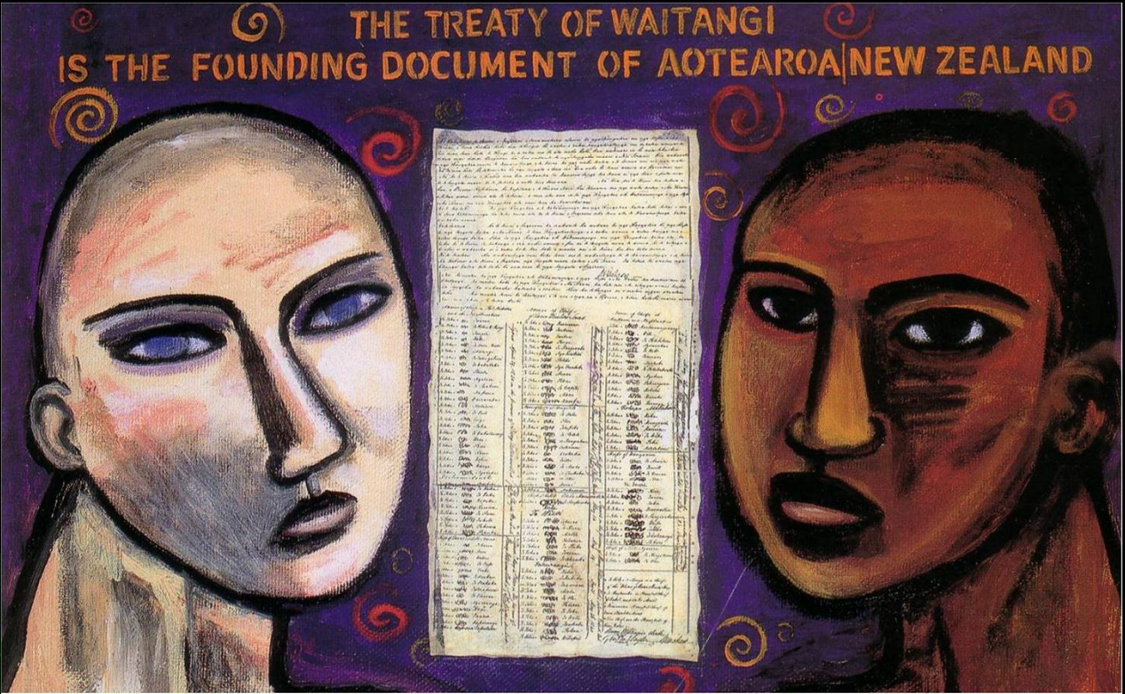
Te Tiriti o Waitangi – Te Mahi Ngātahi Paerewa mō te Ūmanga Whakaakoranga
Me whakaatu i te ngākau nui ki te tikanga o te tangata whenuatanga me te hononga pātui i raro o Te Tiriti o Waitangi, i Aotearoa.
Me mārama, ā, me mōhio ki te mana ahurei o te tangata whenua i Aotearoa nei.
Me mārama, ā, me whakaae ki ngā hītori, ki ngā tukuihotanga, ki ngā reo me ngā ahurea o ngā hoa pātui i roto o Te Tiriti o Waitangi.
Me whakamahi, ā, me whakawhanake i te reo me ngā tikanga Māori.
Robyn Kahukiwa, Te Aitanga-ā-Hauiti
Notes:
TE TIRITI O WAITANGI – TE MAHI NGĀTAHI
Koinei te paerewa tuatahi o Ngā Paerewa mō te Ūmanga Whakaakoranga. Tirohia te whakapākehātanga i raro nei:
Demonstrate commitment to tangata whenuatanga and Te Tiriti o Waitangi partnership in Aotearoa New Zealand.
Understand and recognise the unique status of tangata whenua in Aotearoa New Zealand.
Understand and acknowledge the histories, heritages, languages and cultures of partners to Te Tiriti o Waitangi.
Practise and develop the use of te reo and tikanga Māori.
Hei mahi:
Me mahi tahi ki ngā kaiako o te kura kia kōrerongia te paerewa nei. Ki ō koutou nā whakaaro, he aha rawa te ngako o ia kōrero? (Whakarōpūngia pea ngā kaiako kia whakapuakina ō rātau whakaaro ka noho tahi ai kia wānangahia ngā whakaaro o tēnā rōpū, o tēnā rōpū.
He pātai hei tautoko i ngā kōrero:
He aha tā tātou e mōhio ai mō tēnei kōrero, mō te ‘tangata whenua’?
Me pēhea tātou e whakamana ai i te tangata whenua o tō tātou rohe, otirā i ngā tātai kōrero, i ngā tikanga tuku iho hoki i tō tātou kura, ka tahi. Ka rua, i ngā akomanga?
Me aha tātou kia whakawhanake ake i te kounga o te reo me te mōhiotanga ki ngā tikanga Māori i roto i tō tātou kura?

Slide 4
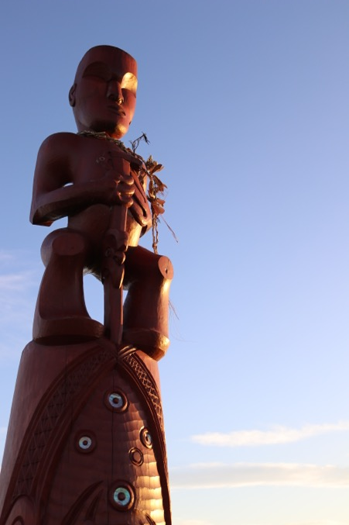
Mana Whenua - Tangata Whenuatanga
He aha tā tātau e mārō ai te taura tangata i waenga i te kura me te mana whenua?
Me pēhea e hono atu ai ngā kaupapa ako o te kura ki te iwi, ki ngā hapū, ki te whānau?
Notes:
Hei tautoko i te wānanga mō te Mana Whenua – Tangata Whenuatanga, tirohia ēnei ki raro nei:
Te Aho Matua: Ngā Iwi 3.4: www.runanga.co.nz/Te+256Aho+Matua.html
Kura ā Iwi Rubric: Mana Whenua Mana Motuhake Rubric Reo Pākehā Position 2_P.pdf
Tātaiako: https://educationcouncil.org.nz/required/Tataiako.pdf
Hei mahi:
Tukuna t/ētahi o ngā tuhinga i Te Aho Matua, i te Māherehere Kura ā-Iwi, i Tātaiako rānei hei pānuitanga, hei kōrerotanga mā ngā kaiako.
Me mahi ā-rōpū kia kōrerohia ngā pātai i te whakaaturanga.

Slide 5
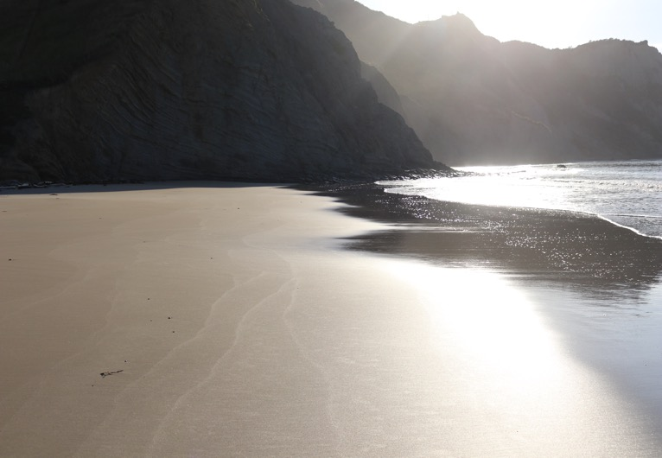
Te reo Māori
He rautaki whakarauora reo tā te iwi?
He aha tā te kura e tutuki ai ngā wāhainga matua o te rautaki reo o te iwi?
He aha tā te kura e pakari ake ai te reo o ngā kaiako?
He aha tā te kaiako e kounga ai tōna reo ake kia pakari ake ai te reo o ngā ākonga?
Notes:
Hei tautoko i te wānanga mō te te reo Māori, tirohia ēnei ki raro nei:
Te Aho Matua: Te Reo 2.3: www.runanga.co.nz/Te+256Aho+Matua.html
Tau mai te Reo: https://www.education.govt.nz/assets/Documents/Ministry/Strategies-and-policies/Ka- Hikitia/TauMaiTeReoFullStrategyEnglish.pdf
Hei mahi:
Tukuna he kape o te rautaki reo o te iwi, te rautaki reo hoki o te kura hei wānanga mā ngā kaiako.
Me mahi ā-rōpū ngā kaiako kia kōrerohia ngā pātai e aro ana ki te reo Māori.
Whakamahia ngā kōrero a tēnā rōpū, a tēnā rōpū kia rapuhia ētahi kaupapa whakangungu e whakapakari ake ai i te reo o te kura, ka tahi. Ka rua, i te reo o te kaiako.

Slide 6
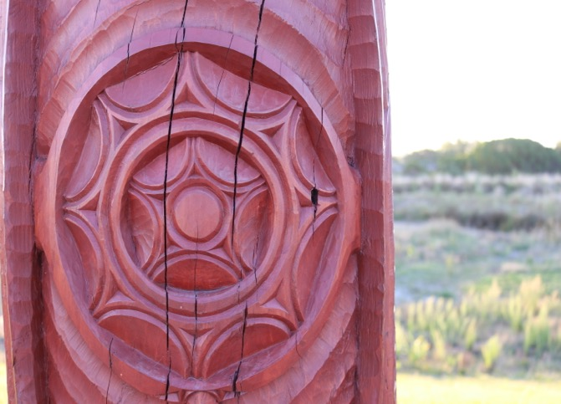
Mana Mokopuna
E hono ana rānei ngā ākonga ki iwi kē atu i Aotearoa?
He aha tā te kura hei whakamana i ērā atu iwi e hono nei ngā ākonga?
E whai angitu ai ngā ākonga me mahi tahi te kura ki a wai?
Notes:
Hei tautoko i te wānanga mō ngā ākonga, tirohia ēnei ki raro nei:
Te Aho Matua: Ngā Iwi 3.1-.3.3 - http://www.runanga.co.nz/Te+256Aho+Matua.html
Te Aho Matua: Te Reo 2.2
Hei mahi:
Ka pēhea tātou e whakatairanga ake ai i te hononga ki ngā iwi katoa o Aotearoa?
He aha tā te kura e whakarite ai hei kaupapa ako kia whakamana i ngā reo matua e rua o Aotearoa – arā ko te reo Māori me te reo Pākehā?
Ka kuhuna rānei e te kura ngā kōrero ā-iwi mō ētahi atu iwi o Aotearoa ki roto i ngā kaupapa ako o te kura?

Slide 7
Rārangi rauemi – ngā hononga
Te Aho Matua: Ngā Iwi / Te Reo
Kura ā-Iwi Rubrics – Mana Motuhake
The Standards for the Teaching Profession: Our Code, Our Standards .
Tau mai te Reo – The Māori Language in Education Strategy 2013-2017
Notes:
Other links and resources

Slide 8
Notes:
End Screen

