Slide 2
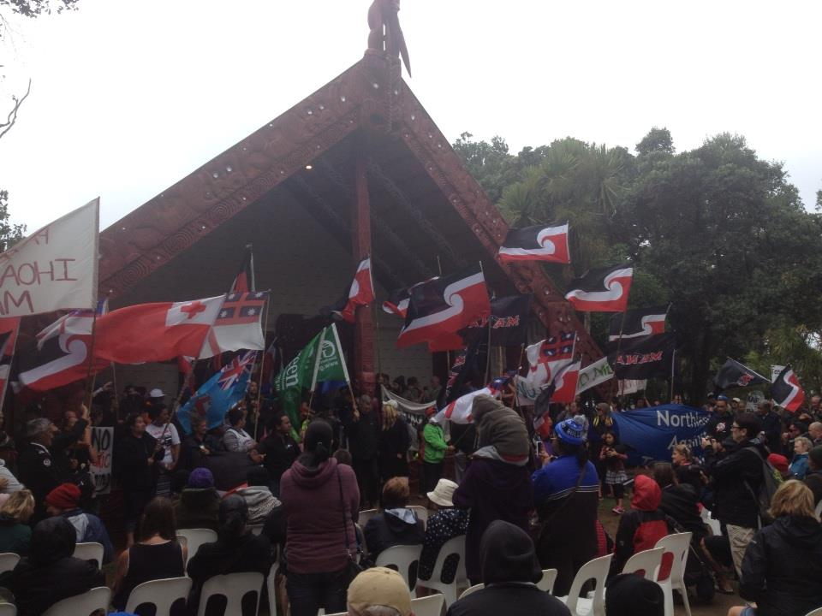
TE TIRITI O WAITANGI
PARTNERSHIP
He Kōrerorero
Notes:
Te Tiriti o Waitangi – Partnership
Nau mai ki te whare kōrero o Ako Panuku – he whare e pūpuri ana i te wairua o Te Tiriti o Waitangi, ka mutu i te wairua hoki o Mahi Ngātahi.
This presentation is focussed on two key guiding documents for teachers:
Standards for the Teaching Profession (The Treaty of Waitangi – Partnership Standard) https://educationcouncil.org.nz/content/our-code-our-standards
- Tātaiako: Cultural Competencies for Teachers of Māori Learners. https://educationcouncil.org.nz/required/Tataiako.pdf
The presentation is designed to be used with whole staff, or a group of teachers to unpack the first of the Standards for the Teaching Professions: Te Tirity o Waitangi Partnership.
How to use this presentation:
Use the presentation in the way that works best for you and your colleagues. Some suggestions might be:
Work with your senior leadership team to plan how to use the presentation with all staff.
Consider the option of a whole day session or a series of staff meetings.
Think about who will facilitate the discussions.
Start with the first two slides.
If you use the presentation over a series of staff meetings, break it into sections – perhaps a different slide for each meeting. Or just use the slides that are most relevant to your school.
Prioritise the Tātaiako competencies (Tangata whenuatanga, Whanaungatanga, Manaakitanga, Wānanga, or Ako) according to your school context, or which you feel most comfortable with. Start with the related slide/s.
If you are having just one meeting, work in groups, with each group looking at the Standard in relation to a different Tātaiako competency.
Give people time to work through the questions – there is a lot to think about so be sure to allow staff the time to reflect.
Consider allowing Māori staff members to work together so that they can work through the ideas in their own way, from their own experiences.

Slide 3
Te Tiriti o Waitangi – Partnership Standard for the Teaching Profession
Demonstrate commitment to tangata whenuatanga and Te Tiriti o Waitangi partnership in Aotearoa New Zealand.
Understand and recognise the unique status of tangata whenua in Aotearoa New Zealand.
Understand and acknowledge the histories, heritages, languages and cultures of partners to Te Tiriti o Waitangi.
Practise and develop the use of te reo and tikanga Māori.
Notes:
THE TREATY OF WAITANGI – PARTNERSHIP is the first of the six Standards for the Teaching Profession. Use this slide to introduce the standard to your staff.
ACTIVITY:
Work with staff, in small groups, to discuss each of the bullet points.
Questions to prompt discussion:
What is your understanding of ‘tangata whenua’?
How do we acknowledge the tangata whenua, local histories and traditional practices in our school and classrooms?
How do we each acknowledge te reo and tikanga Māori in our school, and classrooms?

Slide 4
Activity: Complete the sentence below:
‘Partnership in our school means ...’
…ensuring Māori are involved in decision making. How?
…encouraging everyone’s voices.
How?
…working together for better outcomes for Māori learners. How?
Notes:
ACTIVITY:
Work in pairs or small groups to discuss and complete the sentence.
Use the question bubbles to prompt thinking.
Encourage everyone to think what about what their ideas look like in practice.
Considerations to prompt thinking if needed:
Partnership includes:
working together with iwi, hapū and whānau and the wider Māori community – to encourage and ensure all voices are heard.
allows Māori to be part of the decision making.
acknowledges and uplifts each other’s differences and origins.
establishing honest and genuine relationships.

Slide 5
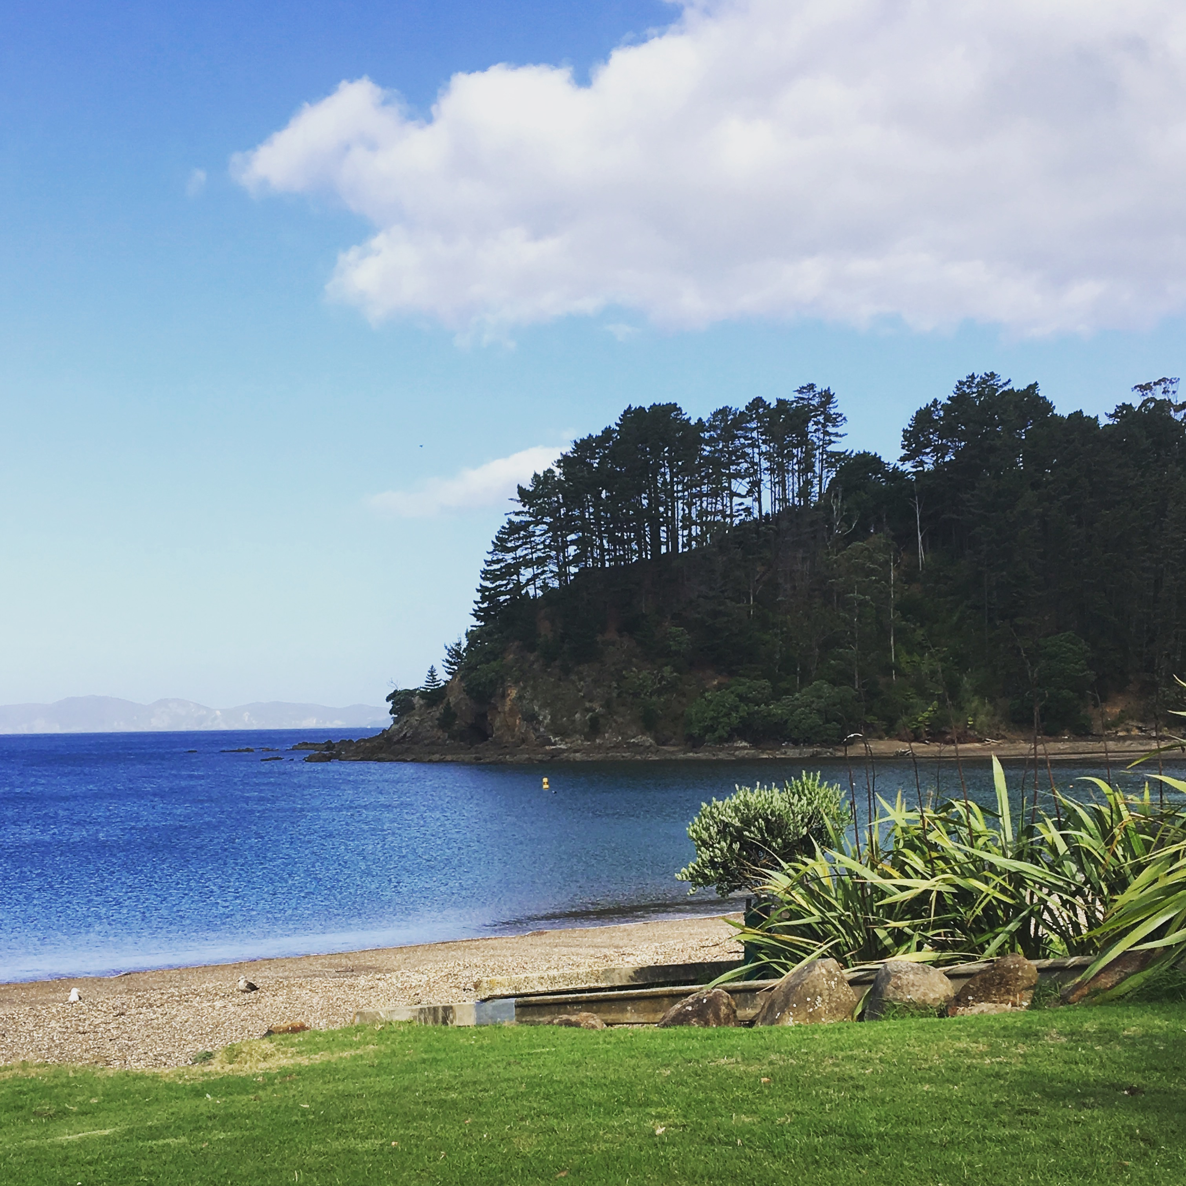
TToW – Partnership & Tangata Whenuatanga Mana Whenua – Place based knowledge
How do we demonstrate our understanding of tangata whenuatanga in our localised curriculum?
How does what we do in our school reflect the local people, their histories and knowledge?
Notes:
TANGATA WHENUATANGA (the first concept in Tātaiako) is about the knowledge, language, culture and identity of the local people – the people whose area the school is located in.
ACTIVITIES:
Work with staff to discuss the questions to identify areas of strength and possible gaps for further planning.
Staff work in pairs or small groups to define ‘tangata whenuatanga’ or “place-based education” in their own words. Share.
Use post-its to gather “one word” ideas about things they know and understand of the local area.
Collect the post-its and create a word cloud to share with all staff. Encourage staff to add to the ‘cloud’ as they learn new things.
Questions to prompt discussion:
How does our local curriculum reflect where we are located - its people, their stories, histories, land and culture?
How do we encourage the teaching and learning of local traditional knowledge and practice in our school programmes?
To what extent do we involve kaumātua from our local Māori community in decision making around school events?

Slide 6
TToW – Partnership & Whanaungatanga
Mana Tangata
How do we ensure whānau feel welcome and valued when:
making decisions that affect their children?
they enter the school or classroom?
planning school events?
Notes:
WHANAUNGATANGA flourishes when we acknowledge and connect with the wider whānau of the school. It’s about shared experiences, working together and respecting each other.
ACTIVITY:
In small groups (departments/syndicates/teams) discuss the terms ‘whānau’ and ‘whanaungatanga’. Create a definition of ‘whanaungatanga’ and report back to the wider staff.
Use each group’s definition to develop a ‘school definition’.
Discuss the questions in the slide – keeping in mind everyone’s understanding of whānau and whanaungatanga.
Questions to prompt discussion:
What do you do to ensure you connect with the Māori community?
Do you acknowledge and understand how your Māori whānau and community operate – how do they communicate with each other, when is the best time to meet with them?

Slide 7
TToW – Partnership & Manaakitanga
Mana Tikanga
Respect, hospitality, support.
Uplifting the ‘mana’ of people connected to the learning environment.
ACTIVITY:
In pairs, or small groups,
discuss the concept of ‘manaakitanga’.
What does this looks like in
our daily practice?
Notes:
MANAAKITANGA, as a core Māori value, involves showing respect to others, taking care of others, being hospitable, and supporting others to be their absolute best.
ACTIVITY:
Use Tātaiako to help you gain a shared understanding of this concept.
Invite staff members to share what this concept means to them. Share examples of what this looks like in the community, on the marae, in homes.
In pairs, discuss this further and invite others to share their understanding and examples of what they do on a daily basis in their classrooms.
Questions to prompt discussion:
What is your understanding of ‘manaakitanga’?
How is manaakitanga different to another culture’s demonstrations of respect and hospitality?
How do you practice ‘manaakitanga’ through your leadership, and school-wide teaching and learning programmes?
How do you show ‘manaakitanga’ when working with Māori whānau and their tamariki?
What support do you offer the local Māori community?
How do you encourage them to have a say?

Slide 8
TToW – Partnership & Wānanga
Mana Mātauranga Māori
ACTIVITY: In small groups or pairs discuss and define …
‘Wānanga’
What is wānanga?
How do we engage with whānau to wānanga matters that affect their tamariki and schooling?
Notes:
WĀNANGA, as a traditional practice, provides the time and space for meeting to discuss and debate, deliberate and consider all thoughts and ideas around important kaupapa.
Here are some links to professional readings about ‘wānanga’ to support you in gaining a better understanding of this core concept:
https://poutamapounamu.org.nz/assets/resources/site/Voices7-15.Wananga.pdf
– NB. Particular reference to ‘Mana Mātauranga Māori’
ACTIVITY:
In small groups or pairs, discuss and unpack the concept of ‘wānanga’ and how it applies (or could apply) to your school. Use Tātaiako to support group discussions.
Questions to prompt discussion:
How often do we provide opportunities for wānanga to occur?
When do we enable others to take a lead role in the wānanga process?
How do we share our knowledge, connect to new knowledge, and recognise and value whānau knowledge in our school?
To what extent do we provide an appropriate space and time for rigorous discussion with whānau about matters that are imporatnt to both the school and whānau?
To what extent are we acknowledging, recognising and researching important traditional, cultural, historical, and genealogical knowledge?

Slide 9
TToW – Partnership & Ako
Mana Mokopuna
Questions:
What do we understand are the learning needs and aspirations of Māori students and their whānau?
What does this mean for what we do?
Reciprocal teaching and learning
Being responsive to the learners’ needs
Creating engaging contexts for learning
Notes:
AKO, as a process of reciprocal learning, ensures that all who are involved in the learning process are valued, and believe they belong, share, and contribute in the learning environment.
ACTIVITY:
Print off and use the TKI reading (http://tereomaori.tki.org.nz/Curriculum-guidelines/Teaching-and-learning-te-reo-Maori/Aspects-of-planning/The-concept-of-ako) to discuss the meaning of ‘ako’.
Unpack the reading to identify key words.
In small groups, draft a sentence to define what ‘ako’ means.
As a staff, discuss each group’s ideas and create a collective definition for your school.
Give examples of what this looks like in the classroom and share with all staff.
Questions to prompt discussion:
How do we each respond to Māori learners’ prior knowledge, experience, and needs?
How do we know that the learning contexts we use and the environment we have created in our classrooms supports Māori learners to feel nurtured in order to grow and develop?
How do we acknowledge the cultural knowledge and potential of Māori learners?
To what extent do we share and encourage discussion about Māori student outcomes and achievement?

Slide 10
Rārangi rauemi – ngā hononga
The Standards for the Teaching Profession: Our Code, Our Standards .
The Cultural Competencies for Teachers of Māori Learners: Tātaiako .
Māori Education Leadership principles: Tū Rangatira
For other Q & A about the Treaty of Waitangi, read here.
Poutama Pounamu offers more insight into the Treaty of Waitangi here.
Talk Treaty provides more reflections on the Treaty.
Notes:
Other links and resources

Slide 11
Notes:
End Screen

